Slide 1
How to make a github account
Author : Sid

Slide 2
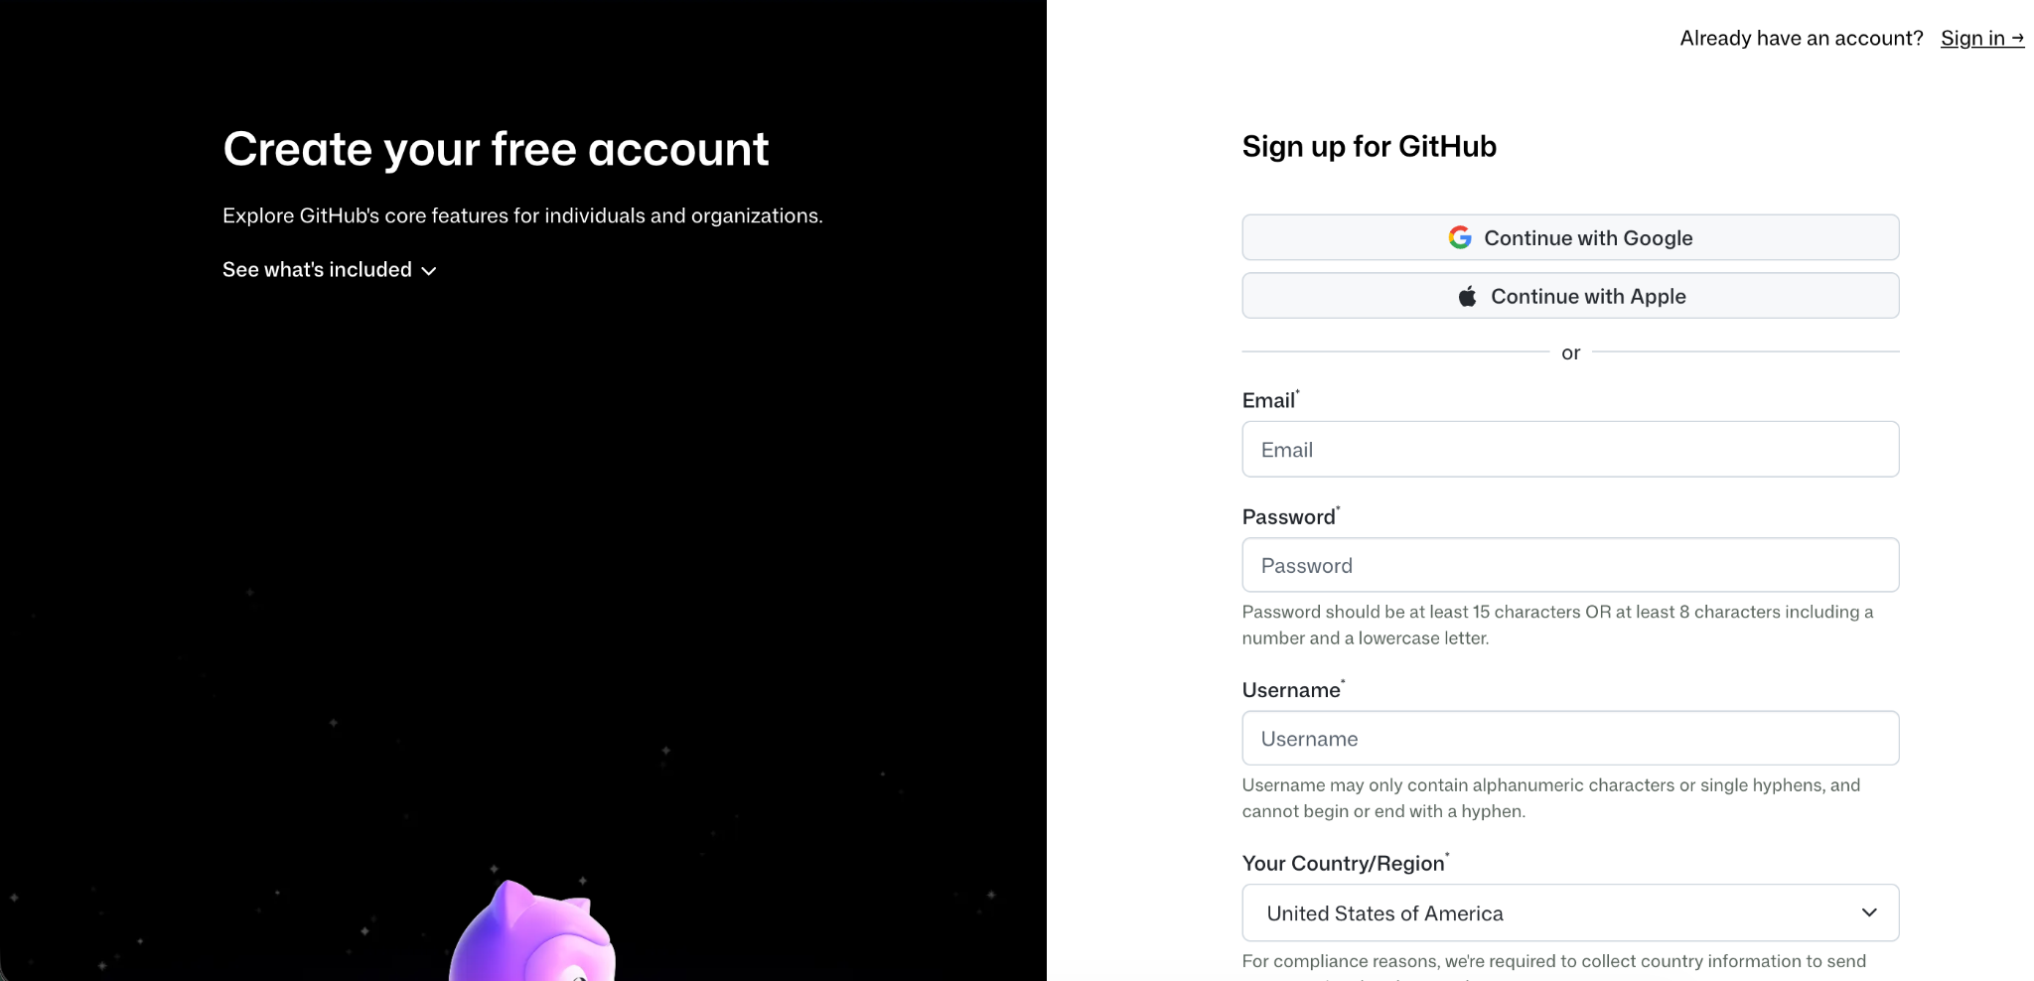
Go to the official page
First you will need to get to the sign up page, from this link official GitHub Signup Page

Slide 3
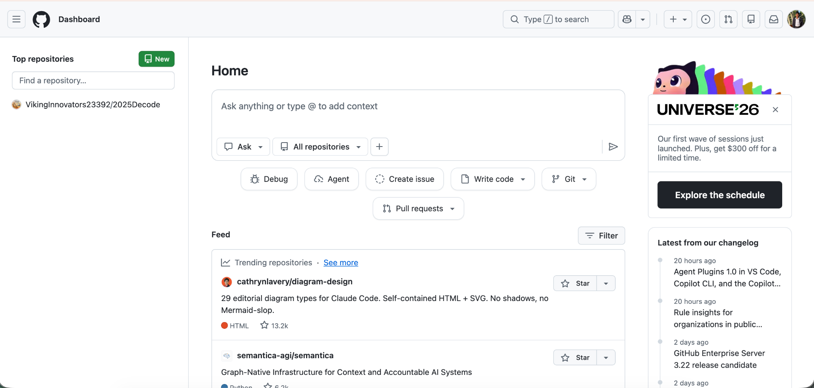
The sign up process
To make an account on github you must type in your email, enter a password, then make your username: do not make it something goofy because this will be public, and then you have to tell which country you are in. done and sign in it will look like this.

Slide 4
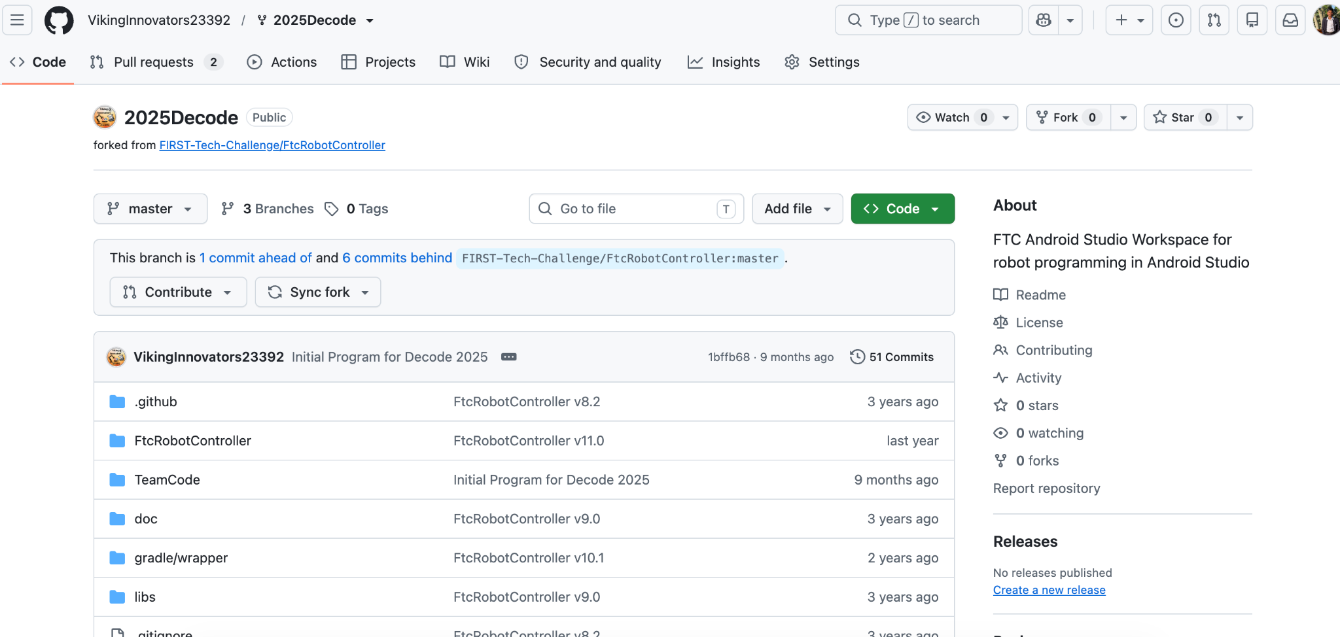
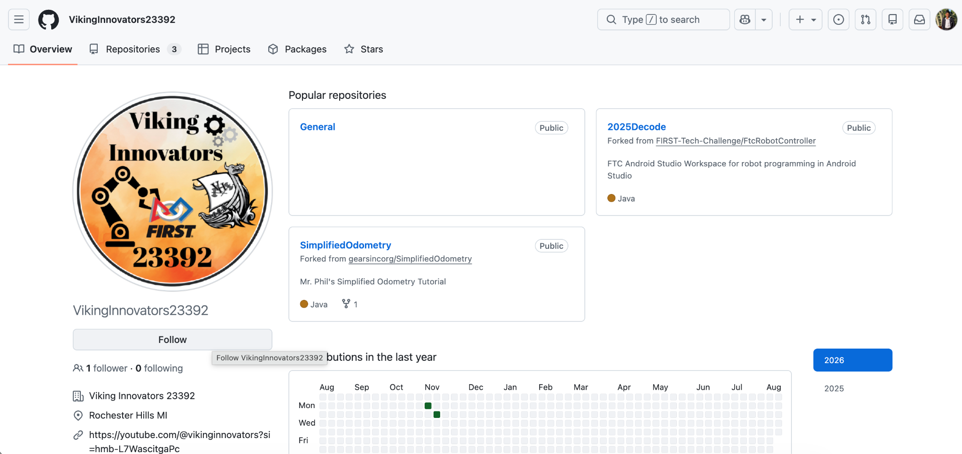
Follow the viking innovators
When your github account is ready you should follow our teams github. Here his the link to the page https://github.com/VikingInnovators23392/ when you are here click on there name Vikinginnovators23392 and follow them!

Slide 5
which apps to use for github
If you are new to github the most recommended app is github desktop. It is free and very beginners friendly. Another app you can use is called fork, fork is a lot faster but it has a paywall of 60$ so if you would like to go on a more efficient app go for fork. What is recommended for robotics and school kids is github desktop because it works very well and is completely free.
https://desktop.github.com/download/
Send me your github account , i will add you as collaborators to vikinginnovators.

Slide 6
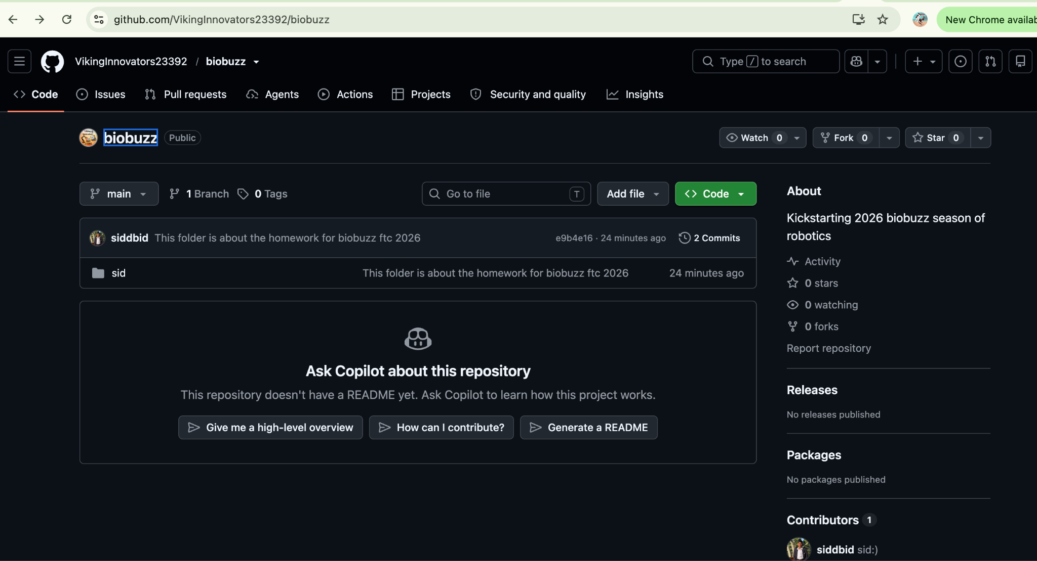
Home Page

